Slide 1
11
Session 11 of 24
Exploring and visualising with Python
How do we explore an unfamiliar dataset in one sitting and find what is worth reporting?
Jotham Martin Wambi, KLAi Professional Learning
Session 11 Exploring and visualising with Python
1
Notes:
Today's file is one you have never seen, which is where most analysts start. Last time you asked a database questions in SQL. Now you learn what to do in your first hour with an unfamiliar file. That's called exploring, and it has a routine you can repeat on any file. We'll draw charts with two libraries, matplotlib and seaborn, and we'll hunt for a result that fools almost everyone the first time. By the end you'll have a notebook with charts and three findings written in plain words, each with a number and a limit.

Slide 2
By the end of today
How the two hours run
Run a repeatable EDA routine.
Recall and warm-up
10 min
Make histograms, scatter, bar and line charts with matplotlib and seaborn.
Concepts and explanation
30 min
Live demonstration
25 min
Write a finding that states a number and a limit.
Break
5 min
Guided lab
40 min
Check and wrap-up
10 min
Session 11 Exploring and visualising with Python
2
Notes:
By the end you'll run a routine for exploring a new dataset, the same steps in the same order. You'll draw histograms, scatter plots, bars and lines with matplotlib and seaborn. And you'll write a finding that states a number and says where it stops being true. The live part builds the charts one at a time, and in the lab you draw six of your own and write three findings.

Slide 3
Vocabulary
Word | Plain meaning | In a spreadsheet
EDA | Exploratory data analysis: a fixed routine of looks, summaries and charts you run on a new file before you model or report. | Scrolling, filtering and pivoting a new sheet to get to know it
Axes | The chart area of a matplotlib figure, where the line or bars are drawn and labelled. | The plot area of a chart
Hue | A seaborn setting that colours the marks by the values of a column. | One colour per group in a chart legend
Rate | A count divided by what could have happened, such as returns per 100 lines sold. | A calculated column that divides one column by another
Seasonality | A pattern that comes back at the same time every year, such as a December peak. | The same bump in a line chart each year
Finding | One sentence that states a number, a comparison and a limit. | The sentence you type under a chart before you send it
Session 11 Exploring and visualising with Python
3
Notes:
Six words come with exploring. EDA is short for exploratory data analysis, the routine of getting to know a new file. Axes is the chart area where matplotlib draws. Hue is seaborn's way of colouring by a column. A rate is a count divided by what could have happened. Seasonality is a pattern that comes back every year. And a finding is one sentence with a number, a comparison and a limit. Each has a spreadsheet cousin in the right-hand column, so none of this is far from what you already do.

Slide 4
Warm-up from Session 10
1
In SQL, what is the difference between WHERE and HAVING?
WHERE picks rows before grouping. HAVING picks groups after the counting.
2
Why did you check each SQL answer against pandas?
Two routes to the same number is the best evidence the number is right.
Session 11 Exploring and visualising with Python
4
Notes:
Two questions about SQL before we start exploring.
First. In SQL, what is the difference between WHERE and HAVING? Have a think.
WHERE picks rows before any grouping happens. HAVING picks groups after the counting is done. If you want only branches with more than a thousand orders, that's HAVING, because the count only exists once the groups are made.
Second. You checked each SQL answer against pandas. Why bother with a second route? No rush.
Because two different routes to the same number is the best evidence you have that it's right. Today we lean on that habit again, because a chart can look convincing even when the numbers behind it are wrong.

Slide 5
The EDA routine in six steps
Look
Describe
One column
Two columns
Groups
Write
shape, types, missing
one summary per number column
compare with counts and rates
a finding in one sentence
a histogram for its shape
a scatter plot
Same steps, same order, on every new file.
Session 11 Exploring and visualising with Python
5
Notes:
Here's the idea that organises today. When you meet a new file, you don't start with a model or a report. You explore it. People call this EDA, short for exploratory data analysis. It's what you do in Excel when you scroll, filter and build a quick pivot to get to know a sheet. In Python we write the routine down, so it runs the same way every time.
First, look. Shape, types and missing values. You did this in Session 7, and it never stops being the first move.
Second, describe. One summary for each number column. Count, mean, median, smallest and largest.
Third, one column at a time. Draw a histogram to see its shape.
Fourth, two columns together. A scatter plot shows whether they rise and fall together.
Fifth, compare groups. Branches, months, payment methods. This is where counts and rates both matter, and we'll spend some time here.
Sixth, write. A finding in one sentence. If you can't write the sentence, you haven't finished exploring.

Slide 6
Load the orders and describe the order value
import pandas as pd
orders = pd.read_csv('orders.csv', parse_dates=['order_date'])
print(orders.shape)
orders.order_value_ugx.describe().round(0)
Output
(30229, 7)
count 30229.0
mean 47491.0
50% 23200.0
max 3104000.0
1
Read the orders. Dates are read as dates.
2
shape: 30,229 rows and 7 columns.
3
describe gives count, mean, median and range.
Session 11 Exploring and visualising with Python
6
Notes:
We start where Session 7 started, with a load.
We read the orders file, and we ask pandas to treat order_date as dates, which matters when we draw a line over time.
The first print gives the size. Thirty thousand two hundred and twenty nine orders and seven columns. Later we'll bring in the order lines, the returns and the branches.
The last line is the describe step. The middle order is worth twenty three thousand two hundred shillings. The mean is forty seven thousand four hundred and ninety one, and the biggest is over three million. You've seen that skew before, and the charts today will show it again.

Slide 7
matplotlib: a page, a chart area and labels
matplotlib is the drawing library under almost every Python chart. Every chart is built in the same order.
Figure
The blank page. plt.subplots() makes one.
Axes
The chart area on the page. You draw on it.
Draw
ax.plot, ax.bar and ax.hist add a line, bars or a histogram.
Label
ax.set_title and ax.set_ylabel add the words.
Session 11 Exploring and visualising with Python
7
Notes:
matplotlib is the drawing library under almost every Python chart. It has two parts to know.
The figure is the blank page. The axes is the chart area on that page, with its two scales and the line or bars inside. You make both with one call, plt.subplots, then you draw on the axes and label it.
In Excel you'd select a chart, then add a title and axis titles. Same jobs. Here you write each one as a line, so the chart can be rebuilt tomorrow with new data and no clicking.

Slide 8
Draw monthly revenue as a line
import matplotlib.pyplot as plt
orders['month'] = orders.order_date.dt.to_period('M')
monthly = orders.groupby('month').order_value_ugx.sum() / 1e6
fig, ax = plt.subplots()
ax.plot(monthly.index.astype(str), monthly.values, marker='o')
ax.set_title('Monthly revenue, sample')
ax.set_ylabel('UGX millions')
print(ax.get_title(), '|', len(ax.lines), 'line')
Output
Monthly revenue, sample | 1 line
1
Total the order value for each month, in millions.
2
Make the page, then draw one line with a dot per month.
3
A title and the units go on every chart.
Session 11 Exploring and visualising with Python
8
Notes:
Let's draw a line. Revenue by month.
The first two lines add up the order value for each month and divide by a million, so the axis will read in millions of shillings.
Then plt.subplots gives us the page and the chart area. We draw one line on the chart area, with a dot at each month so every month is visible.
Last, we label. A title, and a y label that says what the units are. Without units, nobody knows what the numbers mean.
The print confirms the chart holds one line and carries our title. The picture itself you'll see in your own notebook.

Slide 9
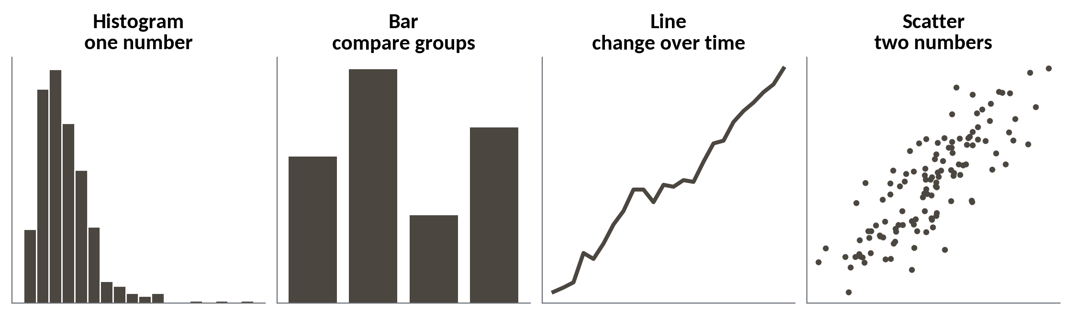
Pick the chart from the question
Ask what you want to know first. The chart follows.
One number. Histogram. Where do most values sit?
Groups. Bar. Which is bigger?
Over time. Line. Is there a pattern?
Two numbers. Scatter. Do they move together?
Session 11 Exploring and visualising with Python
9
Notes:
Before more code, a quick decision guide. The picture shows the four charts we use most, each tied to a question.
One number, and you want to see its shape? A histogram. A comparison between groups? Bars. Change over time? A line. Two numbers, and you want to know whether they rise and fall together? A scatter plot.
In Session 3 you made these choices in Sheets. The choice is the same in Python. Only the drawing changes.

Slide 10
seaborn: the shape of basket size
import seaborn as sns
lines = pd.read_csv('order_lines.csv')
basket = lines.groupby('order_id').size().rename('basket_size')
orders = orders.merge(basket, on='order_id')
sns.histplot(data=orders, x='basket_size', binwidth=1)
print(orders.basket_size.median(), round(orders.basket_size.mean(), 2))
Output
2.0 3.24
1
Count the lines on each order and attach the count to orders.
2
histplot draws it. binwidth=1 gives one bar per basket size.
3
The median is 2 lines, the mean 3.24.
Session 11 Exploring and visualising with Python
10
Notes:
Now seaborn. It sits on top of matplotlib and gives you good looking statistical charts in one line. You hand it the table and name the column.
First, we read the order lines file, one row for each product on an order. Then basket size. That is my name for the number of lines on an order, the number of products rung up. We count the lines for each order and attach that count to the orders table.
Then histplot draws the histogram. A bin width of one gives one bar for each basket size.
The numbers beneath tell the same story. The median basket is two lines and the mean is three point two four. It's the same shape as order value, a tall left side and a long tail to the right.

Slide 11
seaborn: do bigger baskets cost more
ax = sns.scatterplot(data=orders.sample(2000, random_state=1),
x='basket_size', y='order_value_ugx',
hue='payment_method')
print(round(orders.basket_size.corr(orders.order_value_ugx), 2))
orders.groupby('basket_size').order_value_ugx.median().head(4)
Output
0.3
1 7000.0
2 16020.0
3 26790.0
4 36600.0
1
One dot per order. We draw 2,000 so dots do not hide each other.
2
hue colours the dots by payment method.
3
The correlation is 0.3, a modest link.
Session 11 Exploring and visualising with Python
11
Notes:
Two columns together. A scatter plot puts one dot on the page for each order.
We draw only two thousand orders, picked at random. Thirty thousand dots would sit on top of each other and hide the pattern. The hue setting colours the dots by payment method, so you can see whether one method behaves differently.
The correlation is zero point three. In Session 4 you read a correlation, and zero point three is a modest link.
The medians show it. One line is worth about seven thousand shillings, two lines sixteen thousand and twenty, three lines twenty six thousand seven hundred and ninety, and four lines thirty six thousand six hundred. More lines means more value, though loosely, because one line can be an expensive item.

Slide 12
A wrong column name stops seaborn
sns.barplot(data=orders, x='branch', y='order_value_ugx')
1
seaborn looked for a column called branch and found none.
Output
ValueError: Could not interpret value `branch` for `x`.
Session 11 Exploring and visualising with Python
12
Notes:
Here's the error you'll meet most with charts. We ask for a bar chart by branch, but the column in the table is called branch_id, and we typed branch.
Read the last line, as we practised in Session 5. Could not interpret value branch for x. An entry with this name does not appear in data. In plain words, seaborn looked for a column called branch and found nothing.
The fix is quick. Print orders.columns and copy the name exactly.

Slide 13
seaborn: revenue for each branch as bars
ax = sns.barplot(data=orders, x='branch_id', y='order_value_ugx',
estimator='sum', errorbar=None)
print(len(ax.patches), 'bars')
Output
8 bars
1
estimator='sum' adds up the values in each bar.
2
Eight bars, one for each branch.
Session 11 Exploring and visualising with Python
13
Notes:
That error has a quick cure. The column is called branch_id, so we type that, and ask for the total order value for each branch.
The estimator setting tells seaborn what to do with the values in each bar. Here it adds them up. Without it seaborn draws the average, and a bar of averages answers a different question. Setting errorbar to None switches off the thin lines it would otherwise draw on top of each bar.
Our check is the count of bars. Eight, one for each branch. In the picture in your notebook, the tallest bars are Kampala Central and Kampala Ntinda, in line with the totals from Session 10.

Slide 14
Count the returns for each branch
returns = pd.read_csv('returns.csv').merge(orders[['order_id', 'branch_id']], on='order_id')
lines = lines.merge(orders[['order_id', 'branch_id']], on='order_id')
by_branch = pd.DataFrame({'returns': returns.groupby('branch_id').size(),
'lines': lines.groupby('branch_id').size()})
branches = pd.read_csv('branches.csv')
by_branch = by_branch.join(branches.set_index('branch_id').branch_name)
by_branch.sort_values('returns', ascending=False).head(3)
Output
B01 321 19169 Kampala Central
B07 293 9227 Fort Portal
B02 266 15567 Kampala Ntinda
1
Attach the branch to every return and every line sold.
2
Count returns and lines for each branch in one table.
3
Sort by returns, largest first.
Session 11 Exploring and visualising with Python
14
Notes:
Now we compare groups. Which branch has the most returns?
The returns table knows the order but not the branch, so we attach the branch from the orders table with a merge, as in Session 9. We do the same for the lines table, because we'll need it in a moment.
Then we build one small table with the number of returns and the number of lines sold for each branch, and add the branch names.
Sorted by returns, Kampala Central leads with three hundred and twenty one. Fort Portal is second with two hundred and ninety three, and Kampala Ntinda third with two hundred and sixty six. Remember the lines column. Kampala Central sold nineteen thousand lines. Fort Portal sold under ten thousand.

Slide 15
Divide by what was sold to get a rate
by_branch['per_100'] = (by_branch.returns / by_branch.lines * 100).round(2)
by_branch.sort_values('per_100', ascending=False)[['branch_name', 'returns', 'per_100']].head(3)
Output
B07 Fort Portal 293 3.18
B08 Gulu 221 2.36
B05 Mbale 231 2.35
1
Returns divided by lines sold, times 100.
2
Sort the rate, largest first.
Session 11 Exploring and visualising with Python
15
Notes:
Now the question that matters. Is a branch returning more, or just selling more?
We divide returns by lines sold and multiply by a hundred. That gives returns per hundred lines, which is a rate. In a sheet it's a calculated column that divides one column by another.
Then we sort by the rate. Fort Portal now leads, at three point one eight returns for every hundred lines. Gulu is next at two point three six, then Mbale at two point three five.
And Kampala Central, the leader a moment ago, has dropped to one point six seven. Let's see both answers side by side.

Slide 16
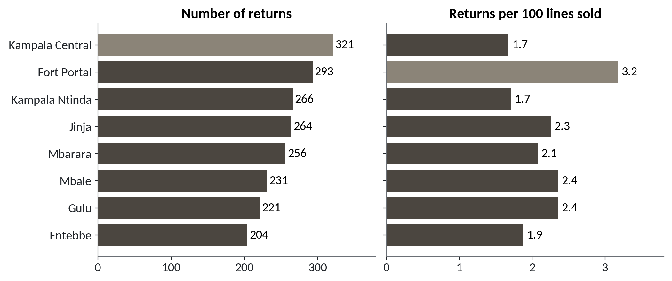
The count and the rate name different branches
1
By count, Kampala Central leads with 321 returns.
2
By rate, Fort Portal leads with 3.2 returns per 100 lines.
3
Kampala Central's rate is 1.7, below the 2.1 average.
Same returns, two questions. The count follows size. The rate shows risk.
Session 11 Exploring and visualising with Python
16
Notes:
Same data, two questions, two panels.
The left panel counts returns. Kampala Central has the longest bar, shaded lighter, with three hundred and twenty one.
The right panel shows returns per hundred lines sold. Now Fort Portal has the lighter bar, at three point two.
And look at Kampala Central again. Its rate is one point seven. Across all eight branches the rate is two point one, so Kampala Central is below the average. It has many returns because it sells many lines.
If a manager asked you which branch to visit about returns, which one would you name? Sit with it for a second.
Fort Portal. Its customers return about one line in thirty one, against one in sixty for Kampala Central.

Slide 17
A long bar can point at the wrong branch
What it looks like
Why it goes wrong
The fix
You rank the branches by number of returns and send a quality visit to Kampala Central. The chart is right, the code runs and nothing warns you.
Kampala Central sold 19,169 lines in the sample, more than double the 9,227 at Fort Portal. More sales means more returns, even when customers are happier.
Divide by what was sold. Show the rate beside the count, and say which one you used.
Session 11 Exploring and visualising with Python
17
Notes:
Here's the trap for today, and it makes no error at all.
You rank the branches by the number of returns, and you send a quality visit to Kampala Central. The chart is correct. The code runs. Nothing warns you.
The trouble is size. Kampala Central sold nineteen thousand one hundred and sixty nine lines in our sample, which is more than double the nine thousand two hundred and twenty seven at Fort Portal. A big branch has more of everything, including returns.
To fix it, divide by what was sold and show the rate beside the count. Then tell your reader which of the two you used.

Slide 18
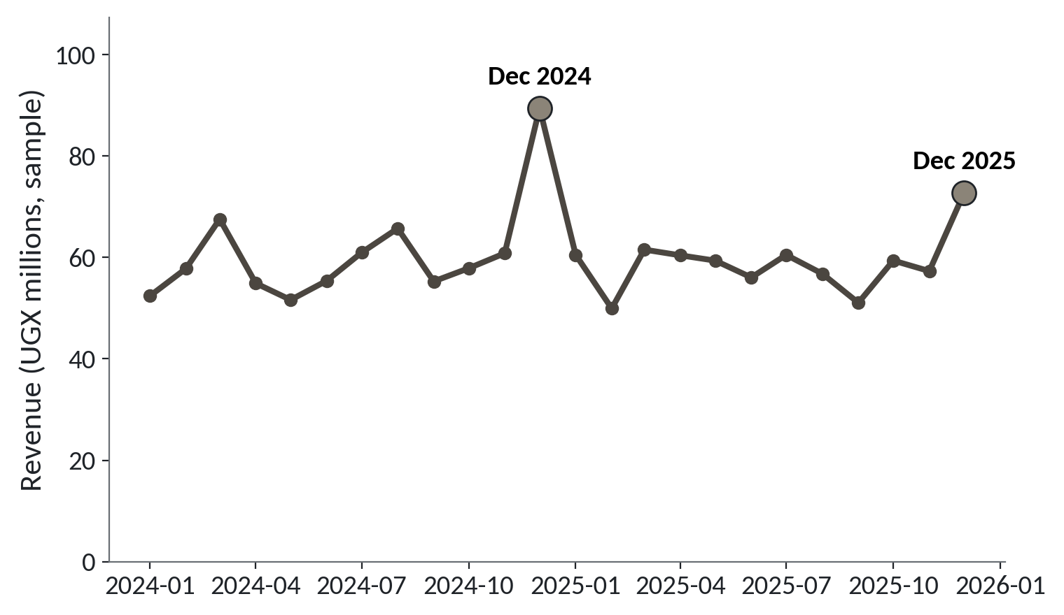
Revenue peaks every December
1
Most months sit between about 50 and 68 million shillings.
2
December 2024 jumps to 89.5 million.
3
December 2025 jumps again, to 72.8 million.
Sample revenue by month, UGX millions. December is the peak in both years.
Session 11 Exploring and visualising with Python
18
Notes:
Now a pattern over time. Seasonality is a pattern that comes back at the same time every year. In a line chart you spot it as the same bump in each year.
Most months sit between about fifty and sixty eight million shillings. This is revenue in our sample of orders.
Then December 2024 jumps to eighty nine point five million. That's the highest point on the chart.
December 2025 jumps again, to seventy two point eight million. Smaller, but the same bump, in the same month. Two Decembers in a row is what makes us say the word seasonality. One December would only be a single high month.

Slide 19
Compare December with every other month
dec = monthly[monthly.index.month == 12]
rest = monthly[monthly.index.month != 12]
print(dec.round(1))
print(round(rest.mean(), 1))
print((dec / rest.mean()).round(2))
1
Split the months into the Decembers and the rest.
2
Average of the other 22 months, in millions.
Output
2024-12 89.5
2025-12 72.8
57.9
2024-12 1.55
2025-12 1.26
3
December as a multiple of that average.
Session 11 Exploring and visualising with Python
19
Notes:
A chart gives you a hunch. A number tests it.
We split the months in two groups. The two Decembers, and the other twenty two months.
The average of the other twenty two months is fifty seven point nine million shillings.
Then we divide each December by that average. December 2024 is one point five five times a normal month. December 2025 is one point two six times. So December ran about fifty five percent above normal in the first year and about twenty six percent above in the second. That's two Decembers, and we'll say so when we write the finding.

Slide 20
Finding
One sentence that states a number, a comparison and a limit.
In our data
In a spreadsheet
Fort Portal has 3.2 returns per 100 lines sold, against 2.1 across all branches. This is a sample of orders, so it shows where to look and says nothing about why.
The sentence you type under a chart or pivot table before you send it to your manager.
Session 11 Exploring and visualising with Python
20
Notes:
The last word for the session. A finding.
A finding is one sentence with three parts. A number, a comparison, and a limit.
Here's one from today. Fort Portal has three point two returns per hundred lines sold, against two point one across all branches. That's the number and the comparison. Then comes the limit. This is a sample of orders, so it shows where to look and says nothing about why.
In Excel it's the sentence you type under a chart before you send it. The limit is the part people leave out, and it is the part the reader most needs.

Slide 21
Weak findings and strong findings
Weak | Strong
Returns are high at Kampala Central. | Kampala Central has the most returns, 321, but only 1.7 per 100 lines, below the 2.1 average. One sample.
December is busy. | December revenue was 89.5 million in 2024 and 72.8 million in 2025, against 57.9 million in other months. Two Decembers only.
Bigger baskets cost more. | The correlation of basket size and order value is 0.3, a modest link. It shows a link and cannot show cause.
Add the number, the comparison and the limit.
Session 11 Exploring and visualising with Python
21
Notes:
Here are three weak findings and their strong versions.
Returns are high at Kampala Central is weak. It has no number, and it's misleading. The strong version gives the count, the rate and the average to compare with, and it names the limit, that this is one sample.
December is busy is weak too. The strong version gives both Decembers, compares them with the other months, and admits we only have two.
Bigger baskets cost more is vague. The strong version says how strong the link is, zero point three, and reminds the reader that a link cannot show cause.
In the lab you'll write three of your own in this shape.

Slide 22
Lab: explore returns and basket size
1
Open the Session 11 notebook and run the setup cell
Tool and time
Google Colab
40 minutes
2
Draw histograms of basket size and order value
3
Draw the scatter of basket size and value
You are done when
Three findings in a notebook cell, each with a number, a comparison and a limit.
4
Count returns and work out returns per 100 lines
5
Find the branch that leads by count but not by rate
6
Write three findings, each with a number and a limit
Session 11 Exploring and visualising with Python
22
Notes:
The lab is forty minutes in Google Colab. The first task is to build basket size, the count of lines on each order, and merge it into orders. Run the setup cell in the Session 11 notebook first.
Then you draw the two histograms and the scatter, count returns for each branch and turn the count into a rate. The moment that matters is when you find the branch that leads by count and does not lead by rate. Say it to your neighbour in one sentence.
The last task is writing three findings, each with a number, a comparison and a limit. You're done when all three are written. If a chart won't draw or a name isn't found, print the column names first.

Slide 23
Questions to finish
1
What two things does plt.subplots() give you?
A figure, the page, and axes, the chart area you draw on.
2
Branch A has the most returns and branch B the highest rate. What do you check next?
How many lines each branch sold. The rate divides by it.
3
What three parts make a finding?
A number, a comparison and a limit.
Session 11 Exploring and visualising with Python
23
Notes:
Three questions on charts and findings. Keep your answers in your head first.
Question one. What two things does plt.subplots give you? Take your time.
A figure, which is the page, and axes, which is the chart area you draw on and label.
Question two. Branch A has the most returns and branch B has the highest rate. What do you check next? Think it over.
How many lines each branch sold, because the rate divides by it. A big branch has more returns just by being big.
Question three. What three parts make a finding? Give that a moment.
A number, a comparison and a limit.

Slide 24
Summary
Explore in the same order every time: look, describe, one column, two columns, groups, write.
A count follows size. A rate divides by what was sold and shows risk.
A finding states a number, a comparison and a limit.
Next session. Inference: is the difference real?
Session 11 Exploring and visualising with Python
24
Notes:
One. Explore in the same order every time. Look, describe, one column, two columns, groups, then write.
Two. A count follows size. A rate divides by what was sold, and it shows where the risk is. Fort Portal and Kampala Central taught us that.
Three. A finding states a number, a comparison and a limit.
Next session asks the question that follows. When two groups differ, how do we know the gap is real and not luck? Bring one difference from today that you'd like to test.

